Slide 1
Feedback Management System
Team Members:
Alwyn Joseph
Abhishek M Gowda
Sharath Adiga
Date Of Submission:
07/09/21
Submitted To:
Dr. Kiran B Malagi
Associative Professor,
Dept. Of ISE

Slide 2
Introduction:
This is a web oriented application that handles the working of the Feedback Management system of an educational institution, by collecting feedbacks from different sources like students, parents, employers etc about the college and its associated activities and a finalized report is in generated according to the feedback provided.

Slide 3
Objective Of the Project:
The main objective of the feedback system is to automate the existing manual system by the help of computerized equipment and full-fledged web oriented application, fulfilling their requirements, so that their valuable data/information can be stored for a longer period with easy accessing and manipulation of the same. The required software and hardware are easily available and easy to work with.

Slide 4
Modules:
Admin Module :
The admin controls the working of the whole system, by adding feedback forms, modifying it and also removing if any of which is unnecessary. It can also view the performance report of each faculties (Here performance report is nothing but an overall report generated solely using the feedbacks provided by the students, which will be later sent to the associated faculties).
The admin can also check if all the students have given the feedbacks.
Also the admin can view the overall report provided by the employers and look into where the institution has to improve.

Slide 5
User Module :
This module deals with the different users who has access to the feedback system i.e., students, employer, parents and alumni.
Here only when a authorised user logs in, the user will be permitted to provide the feedbacks.
Whenever a user logs in, only the feedback forms which are accessible to the user will be visible i.e., for example if an employer logs in then the user will be provided with only a single feedback form called employer feedback form.
Here when faculty member logs in, the user will be provided with his/her overall performance rating and information regarding the improvement that has to be made.

Slide 6
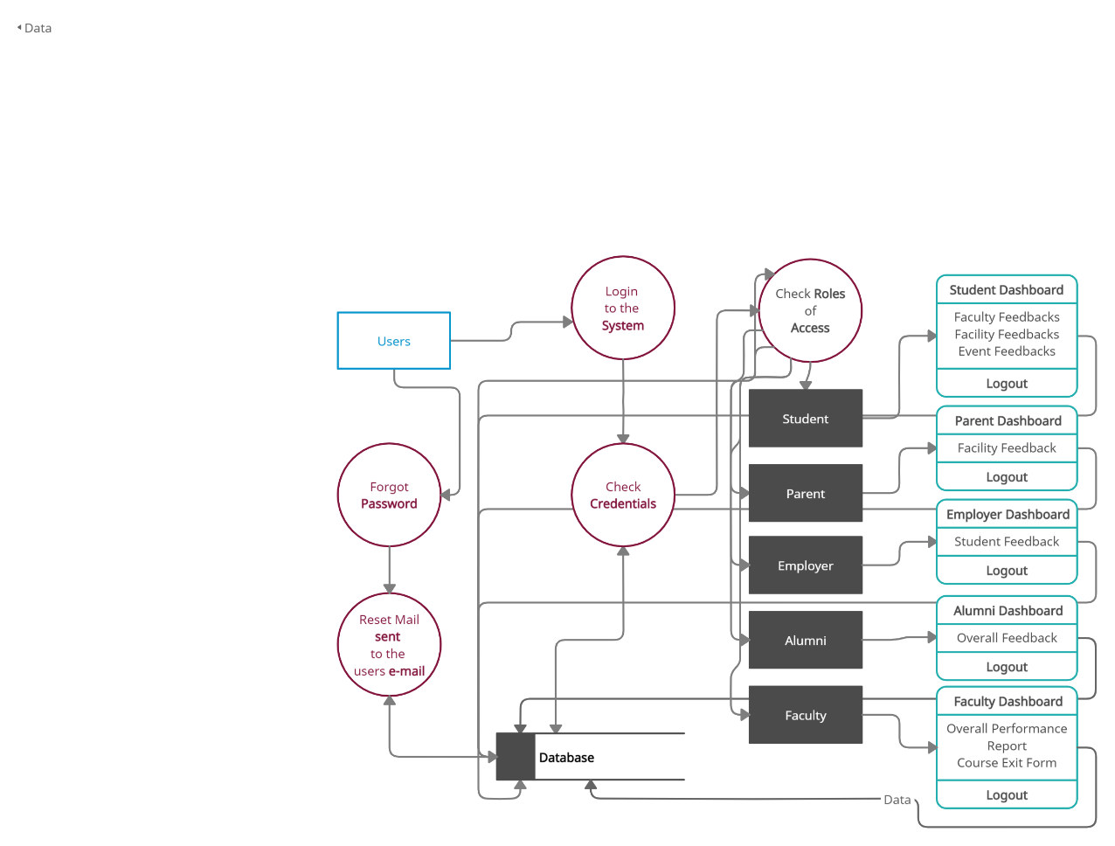
Data Flow Diagram:

Slide 7
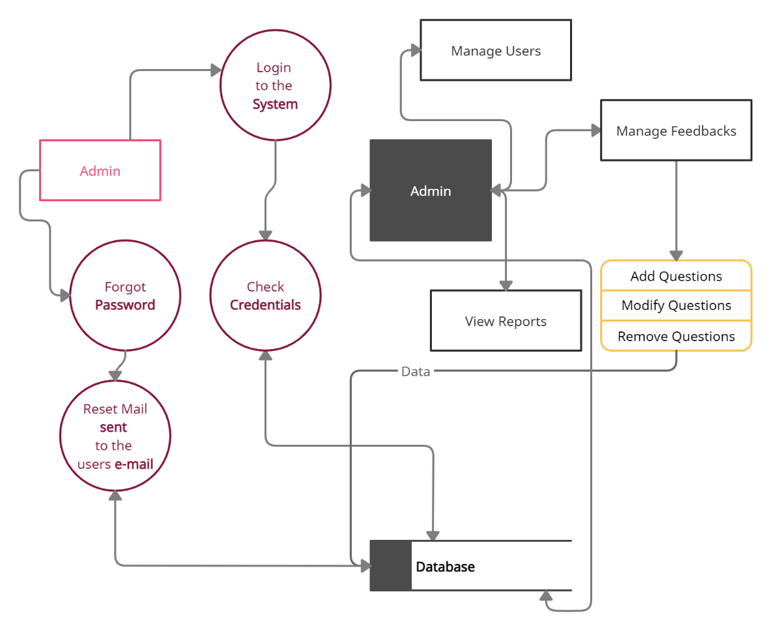

Slide 8
Limitations:
This project is only restricted to web application and there is no mobile version of this project.
This application requires access to Internet
Bandwidth of server must be higher for large number of users.

Slide 9
Scope Of the Project:
We can integrate this web application with the mobile application.
We can host the platform on online servers to make it accessible worldwide, It can reduce the administration burden.

Slide 10
Thank You!

